Slide 1

Visual Interface for Wi-Fi Networks Monitoring
FERRAN SELVA RODRÍGUEZ
Bachelor‘s Degree in telematics engineering
DIRECTOR: JAUME BARCELÓ

Slide 2
OUTLINE
INTRODUCTION
STATE OF THE ART
SYSTEM COMPONENTS
SYSTEM OPERATION
TESTING THE SYSTEM
CONCLUSIONS
FUTURE WORK

Slide 3
INTRODUCTION
Idea:
This thesis aims at providing a tool to monitor the status of the access points of “Barcelona WiFi” and share this information with the citizens

Slide 4

INTRODUCTION
Bottom Up Broadband (BuB):
Defines network design, deployment and operation initiatives driven by end user needs
The individuals, companies or institutions that need the network are the ones that take the initiative and participate in the organization and funding of the project
Difficulties: Agreement among the many parts
Advantages: Deploy networks in regions that are not attractive to commercial operators.

Slide 5
State of the Art
Gowex:
Spanish telecommunication company
Deploys Wi-Fi networks for the cities
Present over 80 cities, like Madrid, Miami or New York
Last New: Gowex File for Insolvency; CEO Quits on
Fake Accounts [El Mundo. Jul 6, 2014 ]
Existing monitoring software:
Pandora FMS
PRTG Network Monitor
Nagios
Munin

Slide 6
State of the Art
Guifi.net tools:
Web Application / qMp: Status and traffic
Munin
Nagios
Barcelona Wifi tools:
Public Information: Location
Private Information: Google Earth application
Status
Location
Current number of Users
Current number of jumps until the Gateway

Slide 7
SYSTEM COMPONENTS
HARDWARE COMPONENTS
Raspberry Pi
Server
Access Points
SOFTWARE COMPONENTS
Access (Java Application)
Web Application
MongoDB Database
Web service

Slide 8
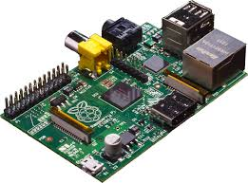
SYSTEM COMPONENTS Hardware COMPONENTS
Raspberry Pi
Credit-Card sized computer
Model B Ethernet
Auto-run the Access java application when it is booted
Figure 1: Raspberry Pi

Slide 9
SYSTEM COMPONENTS Hardware COMPONENTS
Server
Universitat Pompeu Fabra Server
Apache HTTP Provides access to web applications
MongoDB Database stores the data

Slide 10
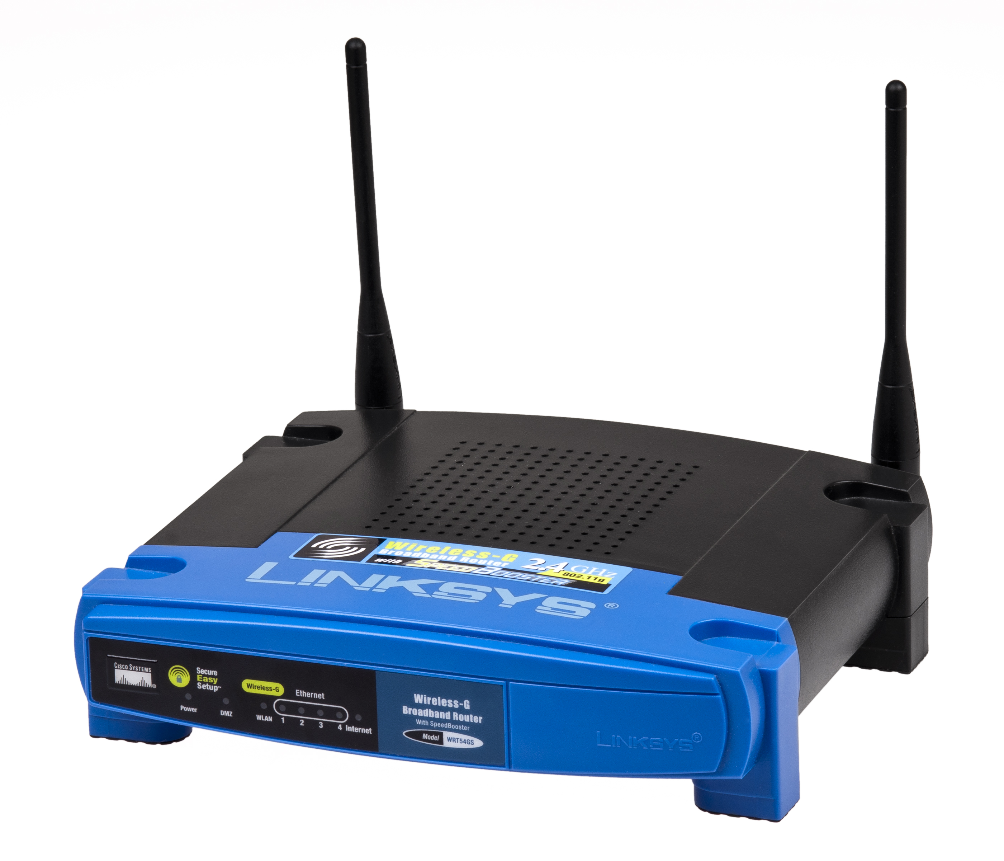
SYSTEM COMPONENTS Hardware COMPONENTS
Access Point
Devices whose performance is being monitored
Figure 2: Linksys WRT54Gt Access Point

Slide 11
SYSTEM COMPONENTS SOFTWARE COMPONENTS
Access (Java Application)
Main goal: Updates the status of the access point to be monitored
Written in Java
Executed at the Raspberry Pi
Methodology:
Get the needed Data to ping the Access Points
Get the Response
Process this information
Send the information to the Database
Ping the Access Points

Slide 12
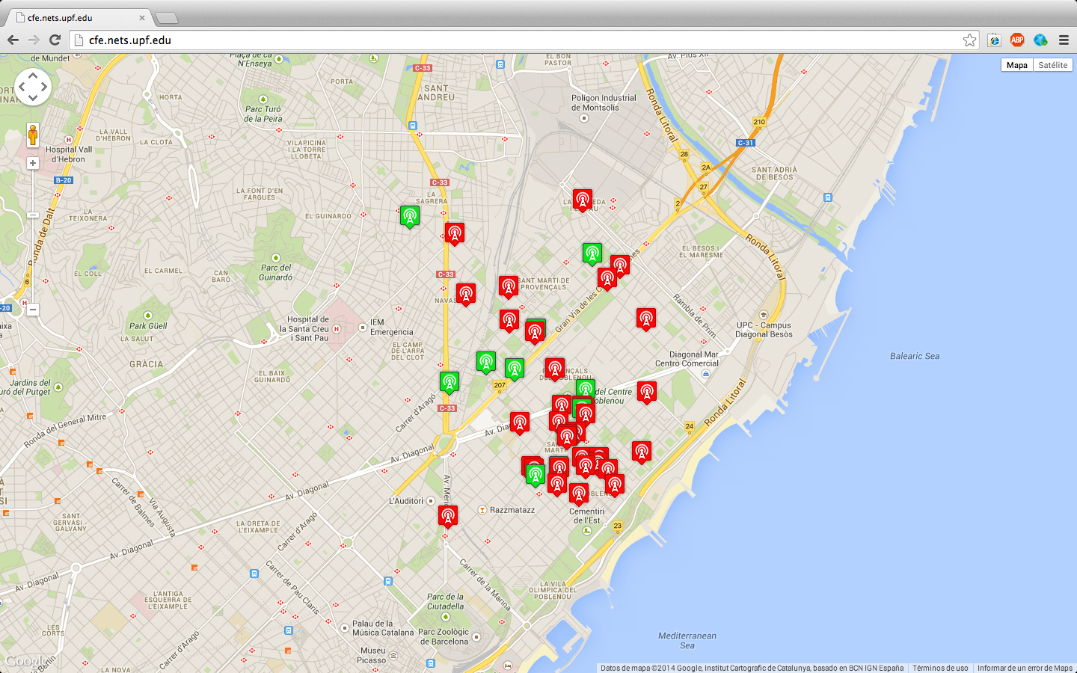
SYSTEM COMPONENTS SOFTWARE COMPONENTS
Web Application
Main goal: Displays the information about the status of the access points
Written in HTML, Javascript and PHP
Located at the server
Figure 3: Web Application

Slide 13
SYSTEM COMPONENTS SOFTWARE COMPONENTS
MongoDB Database (1)
Main goal: Stores the information obtained by the Access java application
Collections:
Resume Stores for each Access Point the following data:
ID
IP
Latitude
Longitude
Status
Since
Totaltime
Uptime
Downtime
Availability

Slide 14
SYSTEM COMPONENTS SOFTWARE COMPONENTS
MongoDB Database (2)
Data A register is stored each time that the Access java application tries to ping an Access Point.
The information stored at each register is:
ID
Status
Timestamp

Slide 15
SYSTEM COMPONENTS SOFTWARE COMPONENTS
Web service
Main goal: provides a way of communication between the Access java application at the Raspberry Pi and MongoDB Database at the server
Written in PHP
Located at the Server

Slide 16
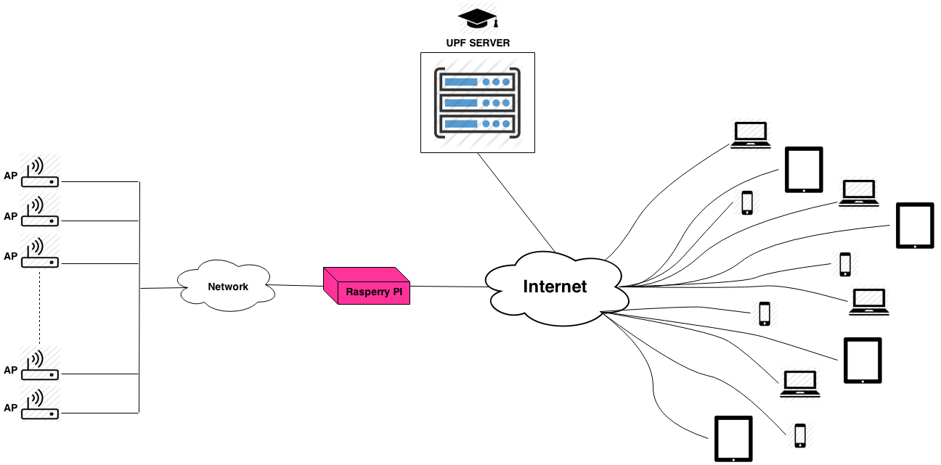
SYSTEM OPERATION
Figure 4: System Diagram

Slide 17
TESTING THE SYSTEM Test
Network: Poblenou Sense Fils.
Location: Barcelona
Number of nodes: 45
Duration: 5 Days.
Location of the Raspberry Pi: Tanger building of the Universitat Pompeu Fabra.

Slide 18
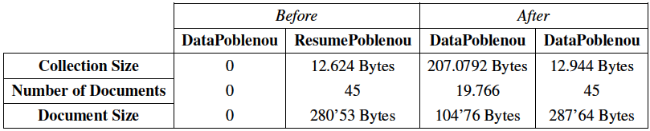
TESTING THE SYSTEM RESULTS
Database Results
Collection Size:
Data: + 2.070.792 Bytes
Resume: + 320 Bytes
Document Size:
Data: +104’76 Bytes
Resume: + 7,11 Bytes
Number of Documents:
Resume: 45 Documents
Data: + 19.766 Documents
Table 1: Summary Table of Collections Stats

Slide 19
TESTING THE SYSTEM RESULTS
Mailing
Address: bub.project.apcontrol@gmail.com
Number of email received: 223 emails
Processing the Information
TOTALTIME: 5 days=120 hours BCNgranvia940AH =119’71
Unexpected stops
There were no unexpected stops.
Anyway, to restart the system is easy Rebooting Raspberry Pi

Slide 20
CONCLUSIONS
The system is simply and inexpensive
The system is compatible with all networks
The results of the test show a good performance
The simplicity leads to miss some information

Slide 21
FUTURE WORK
SNMP Implementation (Libraries for java, like snmp4j)
Obtain more information
Add CONTROL capabilities
Turn On
Turn Off
Reboot
Others
Web Application Improving
View the log of a particular access point
Add search criteria. Options like geographical area, number of users or action point status

Slide 22
Thank you

